Slide 1
Deep Neural Networks
BITS Pilani
Pilani Campus
Instructor in charge: S. Vishali

Slide 2
Time Series Forecasting
It involves predicting future values of a sequence based on its historical data.
A statistical technique that analyzes sequential data to predict future events or trends. .
This data is characterized by its chronological order, with each data point associated with a specific time interval.
Its essence lies in understanding and leveraging the patterns found in historical data to foresee future occurrences.
It's used in various domains like finance, weather forecasting, sales prediction, meteorology, economics, healthcare and more.
It is a linear extrapolation of past data. It involves identifying various underlying factors such as seasonality, trends, and cycles.

Slide 3
Case Studies
Stock Market Prediction:By analyzing historical stock data, these models can identify patterns and trends that are not immediately apparent, enabling investors to make informed decisions.
Weather Forecasting: In meteorology, deep learning models like CNNs and GRUs have been instrumental in forecasting weather conditions. These models analyze vast datasets, including historical temperature, humidity, and pressure readings, to predict future weather patterns with remarkable accuracy.
Healthcare Monitoring: The healthcare industry has also benefitted from deep learning in time series analysis, especially in patient monitoring and disease progression. For instance, LSTMs have been used to analyze continuous data streams from medical devices, helping in early detection of potential health issues.
Energy Demand Forecasting: Deep learning models are increasingly being used in the energy sector to predict demand and consumption patterns. This not only helps in optimizing energy distribution but also aids in planning renewable energy usage.

Slide 4
Challenges and Best Practices in Implementing Deep Learning for Time Series Data
Implementing deep learning techniques for time series forecasting can be challenging, but understanding these challenges and adhering to best practices can lead to successful outcomes.
Data Preprocessing: Time series data often requires extensive preprocessing, including dealing with missing values, noise reduction, and normalization. Effective preprocessing is crucial for the model to learn meaningful patterns.
Model Complexity: Choosing the right model architecture and tuning its parameters can be daunting. It’s important to strike a balance between model complexity and computational efficiency. Simpler models like GRUs might be more suitable for certain tasks, whereas complex models like LSTMs might be necessary for others.
Overfitting: Deep learning models are prone to overfitting, especially when dealing with large datasets. Regularization techniques, such as dropout and early stopping, can help mitigate this issue.

Slide 5
Best Practices:
Start with Simple Models: Begin with simpler models and gradually move to more complex ones as needed. This approach helps in understanding the data and the problem better.
Hyperparameter Tuning: Experiment with different hyperparameters to find the optimal configuration for your model.
Cross-Validation: Use techniques like time series cross-validation to evaluate the model’s performance reliably.
Continuous Monitoring: Once deployed, continuously monitor the model’s performance and update it as necessary to adapt to new data.

Slide 6
Key methods and approaches for time series forecasting
Classical Methods
Autoregressive Integrated Moving Average (ARIMA):
AR (Autoregressive): Uses past values of the series.
I (Integrated): Differencing the data to make it stationary.
MA (Moving Average): Uses past forecast errors.
ARIMA is widely used for univariate time series and is effective when the series is linear and exhibits no seasonality.
Seasonal ARIMA (SARIMA): Extends ARIMA to handle seasonality by including seasonal terms in the model.

Slide 7
Exponential Smoothing (ETS): Uses weighted averages of past observations, giving more weight to recent observations. Variants include:
Simple Exponential Smoothing (SES): For data with no trend or seasonality.
Holt’s Linear Trend Model: For data with a trend but no seasonality.
Holt-Winters Seasonal Model: For data with both trend and seasonality.
Vector Autoregression (VAR): A multivariate model that captures the relationships between multiple time series. It’s an extension of ARIMA for multiple variables.

Slide 8
Machine Learning Approaches
Regression Models:
Linear Regression: Can be used with lag features (past values) as inputs for predicting future values.
Decision Trees and Random Forests: Can capture non-linear relationships in time series data.
Support Vector Machines (SVM): Applied to time series with appropriate feature engineering.
k-Nearest Neighbors (k-NN): Used for time series prediction by finding similar patterns in historical data.
Gradient Boosting Models (e.g., XGBoost, LightGBM): Popular for forecasting tasks, especially with feature engineering. They handle non-linearities and interactions well.

Slide 9
Why Use Deep Learning for Time Series Forecasting
Deep learning doesn’t require explicit programming to recognize patterns.
It learns these patterns directly from the data, making it particularly adept at handling the intricacies of time series data.
Deep learning models can handle large volumes of high-dimensional data, a common characteristic of time series datasets.

Slide 10
Deep Learning Approaches
Recurrent Neural Networks (RNNs): Designed to handle sequential data. Useful for capturing temporal dependencies in time series. However, they may struggle with long-term dependencies.
Long Short-Term Memory (LSTM): A type of RNN that can capture long-term dependencies by addressing the vanishing gradient problem.
Gated Recurrent Units (GRU): Similar to LSTMs but with fewer parameters, making them faster to train.
Convolutional Neural Networks (CNNs): Although originally designed for image data, CNNs can be adapted for time series forecasting by treating the data as a 1D input. They are effective at capturing local temporal patterns.
Temporal Convolutional Networks (TCNs): A specialized form of CNNs that are particularly effective for time series forecasting. They use dilated convolutions to capture long-term dependencies.

Slide 11
Transformers: Originally developed for NLP tasks, transformers are now used for time series forecasting. They use self-attention mechanisms to capture dependencies between different time steps.
Temporal Fusion Transformer (TFT): A specialized transformer model for multi-horizon time series forecasting.
Informer/Autoformer: Optimized for long-term time series forecasting.
Autoencoders: These are used for dimensionality reduction or anomaly detection in time series. Variants like Recurrent Autoencoders can be used for sequence prediction.
DeepAR (Amazon): A probabilistic forecasting model that uses RNNs (LSTM/GRU) and is trained on multiple time series simultaneously.
WaveNet: Uses dilated convolutions for sequence modeling and has been adapted for time series forecasting.

Slide 12
Hybrid Models
ARIMA + Neural Networks: Combining ARIMA (for linear components) and neural networks (for non-linear components) can improve forecasting performance.
CNN-LSTM: Combines CNN layers to extract local features and LSTM layers to capture long-term dependencies.
Ensemble Models: Combining predictions from different models can reduce variance and improve accuracy.
Probabilistic Forecasting
Quantile Regression: Predicts a range of possible future values rather than a single point estimate. Useful for uncertainty estimation.
Bayesian Methods: Incorporates uncertainty in the model parameters and makes probabilistic predictions.
DeepAR: A deep learning approach for probabilistic forecasting, predicting entire probability distributions for future time steps.

Slide 13
Feature Engineering for Time Series
Lag Features: Using previous values as inputs for forecasting future values.
Rolling Statistics: Mean, variance, and other statistics computed over a rolling window.
Time-Based Features: Day of the week, month, hour, etc., can be important for capturing seasonality or trends.
Exogenous Variables: Incorporating additional related time series or external factors (e.g., weather data, economic indicators).
Evaluation Metrics
Mean Absolute Error (MAE): Measures the average magnitude of errors.
Mean Squared Error (MSE) / Root Mean Squared Error (RMSE): Penalizes larger errors more heavily.
Mean Absolute Percentage Error (MAPE): Represents the error as a percentage, making it easier to interpret.
Symmetric Mean Absolute Percentage Error (SMAPE): An alternative to MAPE that avoids division by zero.
R-Squared (R²): Measures the proportion of variance explained by the model.

Slide 14
Advanced Techniques
Multivariate Time Series Forecasting: Predicting multiple related time series simultaneously. Requires more complex models to capture interdependencies.
Anomaly Detection: Detecting unusual patterns or outliers in time series data using forecasting models.
Transfer Learning: Pre-training a model on one dataset and fine-tuning it on another can be useful for time series with limited data.
Meta-Learning: Learning how to adapt models to new time series tasks efficiently.

Slide 15
Tools and Frameworks
Python Libraries:
Statsmodels: For classical models like ARIMA, SARIMA.
Prophet: A library by Facebook for forecasting with an emphasis on seasonality.
TensorFlow/Keras/PyTorch: For building deep learning models.
scikit-learn: For machine learning models and preprocessing.
GluonTS: A toolkit for probabilistic time series modeling.
R Libraries:
forecast: For ARIMA, ETS, and other classical models.
Tidyverts: A modern framework for time series forecasting in R.

Slide 16
Time Series Networks
Can train a neural network to solve three types of time series problems.
NARX Network
predict future values of a time series y(t) from past values of that time series and past values of a second time series x(t). This form of prediction is called nonlinear autoregressive with exogenous (external) input, or NARX and can be written as follows:
y(t) = f(y(t – 1), ..., y(t – d), x(t – 1), ..., (t – d))
Use this model to predict future values of a stock or bond, based on such economic variables as unemployment rates, GDP, etc. can also use this model for system identification, in which models are developed to represent dynamic systems, such as chemical processes, manufacturing systems, robotics, aerospace vehicles, etc.
NAR Network
There is only one series involved. The future values of a time series y(t) are predicted only from past values of that series. This form of prediction is called nonlinear autoregressive, or NAR, and can be written as follows:
y(t) = f(y(t – 1), ..., y(t – d))
Can use this model to predict financial instruments, but without the use of a companion series.

Slide 17
Nonlinear Input-Output Network
Similar to the first type, in that two series are involved, an input series x(t) and an output series y(t). Here, can predict values of y(t) from previous values of x(t), but without knowledge of previous values of y(t). This input/output model can be written as follows:
y(t) = f(x(t – 1), ..., x(t – d))
The NARX model will provide better predictions than this input-output model, because it uses the additional information contained in the previous values of y(t). However, there may be some applications in which the previous values of y(t) would not be available. Those are the only cases where you would want to use the input-output model instead of the NARX model.

Slide 18
Multilayer Perceptrons (MLPs)
applied to time series forecasting by structuring the data appropriately.
MLPs are used in time series forecasting as follows:
Input Representation: Sliding Window Approach
The key to using MLPs for time series forecasting lies in transforming the sequential data into a format that an MLP can handle. This is usually done through a sliding window approach:
Sliding Window: Convert the time series data into input-output pairs by using a fixed-size window of past observations as input (features) and the subsequent observation as the output (target).
For example, if you're forecasting stock prices, and you choose a window size of 5, the input would be the prices of the last 5 days, and the output would be the price of the next day.

Slide 19
Preprocessing the Data
Once the sliding windows are created, the data is reshaped into a 2D format that MLPs can process. The input data would have the shape (samples, features), where samples is the number of sliding windows, and features is the number of time steps in each window.
Model Architecture
An MLP used for time series forecasting consists of:
Input Layer: Takes in the sliding window of past observations.
Hidden Layers: Fully connected (dense) layers with activation functions like ReLU. Additional layers and neurons help capture complex relationships.
Output Layer: Single node for predicting the next time step (regression), or multiple nodes for multi-step forecasting.
Training the Model
The model is trained using a supervised learning approach, with the input being the sliding windows and the target being the corresponding next time step. The training process involves minimizing a loss function, typically Mean Squared Error (MSE) for regression tasks.

Slide 20
Making Predictions
Once trained, the MLP model can be used to make predictions:
Single-Step Prediction: The model predicts the next value based on the latest sliding window of past values.
Multi-Step Prediction: For multiple future time steps, predictions are made recursively. For example, after predicting the next time step, that prediction is added to the sliding window for predicting the subsequent time step.
Pros and Cons of Using MLPs for Time Series Forecasting
Pros:
Simplicity: MLPs are easier to implement compared to recurrent architectures.
Versatility: Can be used for both single-step and multi-step forecasting.
Scalability: Works well with large datasets and can be extended by adding more layers/neurons.
Cons:
No Sequential Memory: MLPs lack the ability to remember long-term dependencies, which is essential in some time series data. This is where LSTMs and GRUs perform better.
Feature Engineering: Often requires manual feature engineering, such as adding lagged variables or using sliding windows.

Slide 21
Long Short-Term Memory (LSTM)
These networks are a type of Recurrent Neural Network (RNN) designed to learn and remember long-term dependencies in sequential data, making them well-suited for time series forecasting.
LSTMs are capable of capturing patterns in time series data over long periods, which is crucial for many forecasting tasks.
Pros and Cons of LSTM for Time Series Forecasting
Pros:
Handles Long-Term Dependencies: LSTMs are designed to capture long-term dependencies in sequential data.
Flexible: Can model complex patterns and trends in time series data.
Good Performance: Often outperforms traditional methods on complex time series forecasting tasks.
Cons:
Computationally Intensive: Training LSTMs can be resource-intensive and time-consuming.
Requires Tuning: Hyperparameter tuning is essential for optimal performance.
Complexity: More complex to implement and understand compared to simpler models.
Using LSTMs for time series forecasting can provide accurate and robust predictions, especially when dealing with complex patterns and long-term dependencies.
Code in python

Slide 22
Recurrent Neural Networks (RNNs)
Overview: RNNs are specifically designed to handle sequential data, making them a natural choice for time series. They have loops that allow information to persist, enabling the network to capture dependencies across time steps.
Use Cases: RNNs are useful for univariate and multivariate time series forecasting, sequence generation, and anomaly detection.
Challenges: Standard RNNs can struggle with long-term dependencies due to the vanishing gradient problem.
Variants:
Long Short-Term Memory (LSTM): An advanced type of RNN designed to address the vanishing gradient problem. LSTMs have memory cells that store information over long sequences, making them effective for capturing long-term dependencies in time series.
Gated Recurrent Units (GRU): A simpler variant of LSTM, with fewer parameters, but often performs equally well in practice. GRUs are faster to train and are widely used in time series forecasting.

Slide 23
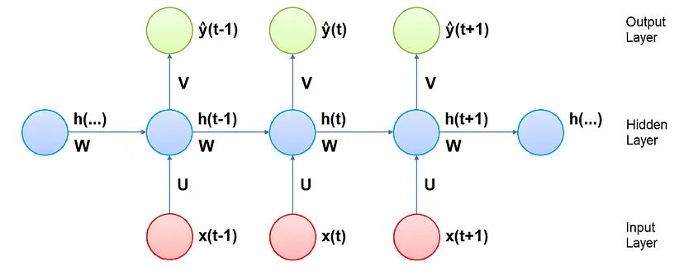
Architecture
Weights - In the RNNs, the input vector at time t is connected to the hidden layer neurons of time t by a weight matrix U, the hidden layer neurons are connected to the neurons of time t-1 and t+1 by a weight matrix W, and the hidden layer neurons are connected to the output vector of time t by a weight matrix V; all the weight matrices are constant for each time step
Input - The vector x(t)​ is the intput of the network at time step t.
Hidden state - The vector h(t)​ is the a hidden state at time t, and is a sort of memory of the network; it is calculated based on the current input and the previous time step’s hidden state:
Output — The vector y^(t) ​is the output of the network at time t:

Slide 24
Long Short-Term Memory (LSTM)
Long Short-Term Memory Networks (LSTM) have been developed to overcome the vanishing gradient problem in the standard RNN by improving the gradient flow within the network. This is achieved using a LSTM unit in place of the hidden layer. As shown in the Figure below, a LSTM unit is composed of:
a cell state, that brings information along the entire sequence and represents the memory of the network;
a forget gate, that decides what is relevant to keep from previous time steps;
an input gate, that decides what information is relevant to add from the current time step;
an output gate, that decides the value of the output at current time step.

Slide 25
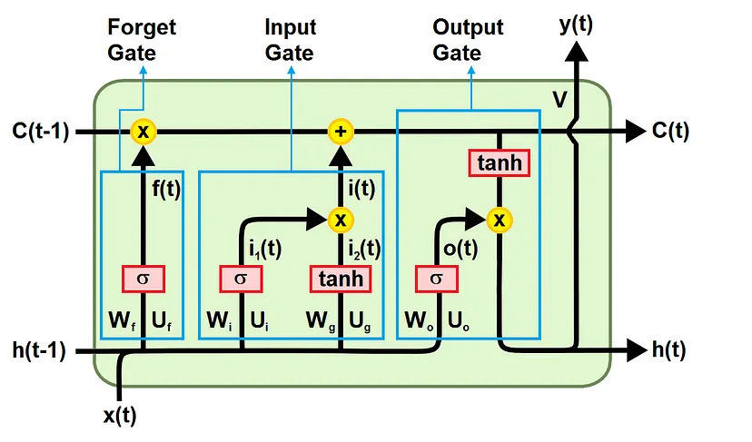
Architecture
The cell state transfers the relevant information during processing, so that also the information from the previous time steps arrives at each time step, reducing the effects of short-term memory.
During training over all the time steps, the gates learn which information is important to keep or to forget, and add them to the cell state, or remove them from it.

Slide 26

Forget Gate
The first gate is the forget gate. This gate decides which information should be deleted or saved. The information from the previous hidden state and the information from the current input are passed through the sigmoid function.
An output is close to 0 it means that the information can be forgotten, while an output close to 1 means that the information must be saved.
Input Gate
The second gate is the input gate. This is used to update the cell state. Initially the previous hidden state and the current input are given as inputs to a sigmoid function (the closer the output is to 1, the more important the information).
It also passes the hidden state and current input to a tanh function to squeeze values ​​between -1 and 1, in order to improve the tuning of the network.
Then the output of the tanh and of the sigmoid are multiplied element by element (in the formula below the symbol * indicates the multiplication element by element of two matrices).
The sigmoid output decides what information is important to keep from the tanh output.

Slide 27
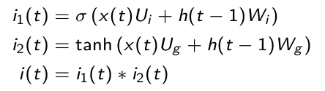

Cell State
After the activation of the input gate, the cell state can be calculated. First, the cell state of the previous time step gets element-wise multiplied by the output of the forget gate.
This gives the possibility to ignore values in the cell state when they are multiplied by values close to 0.
Then the output of the input gate is element-wise added to the cell state. The output is the new cell state.

Slide 28

Output Gate
The third and final gate is the output gate, that decides the value of the next hidden state, which contains information about previous inputs.
First, the previous hidden state and current input are summed and passed to a sigmoid function. Then the new cell state is passed to the tanh function.
At the end the tanh output with the sigmoid output are multiplied to decide what information the hidden state should contain.
The output is the new hidden state. The new cell state and the new hidden state are then carried over to the next time step.

Slide 29
Gated Recurrent Unit (GRU)
The GRU is a new generation of Recurrent Neural Networks and is very similar to an LSTM.
To solve the vanishing gradient problem of a standard RNN, GRU uses the update gate and reset gate.
These are two gates decide what information should be passed to the output. These two gates can be trained to keep information from many time steps before the actual time step, without washing it through time, or to remove information which is irrelevant for the prediction.
If carefully trained, GRU can perform extremely well even in complex scenarios.
GRU unit is composed of the following and shown in below figure
a reset gate, that decides how much of the information from the previous time steps can be forgotten;
an update gate, that decides how much of the information from the previous time steps must be saved;
a memory, that brings informations along the entire sequence and represents the memory of the network.

Slide 30
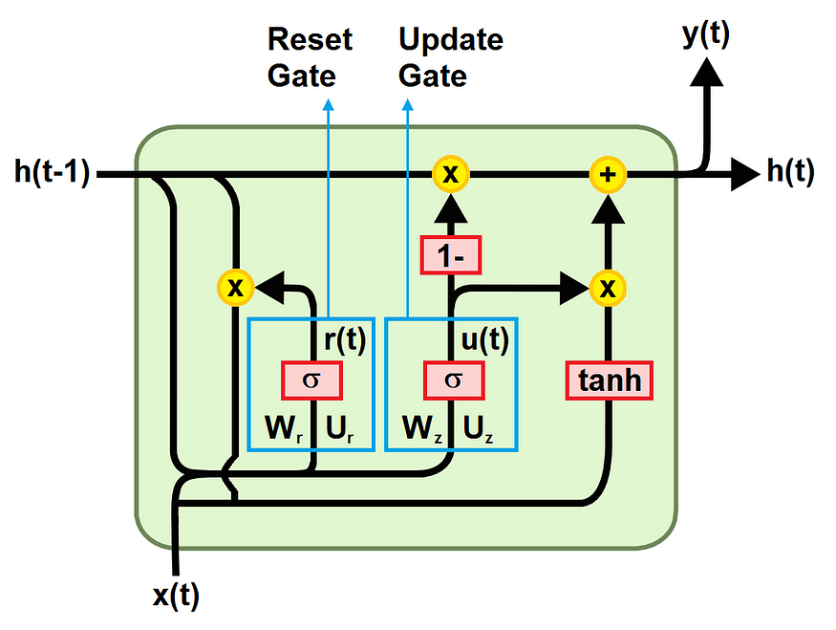
Architecture
Reset Gate
The first gate is the reset gate. It determines how to combine the new input with the previous memory, deciding how much of the information from previous time steps can be forgotten.
First the weighted sum between the input x(t) and the memory h(t-1), which holds the information for the previous t-1 steps, is performed. Then a sigmoid activation function is applied to squash the result between 0 and 1.

Slide 31

Update Gate
The second gate is the update gate. It helps the model to determine how much of the information from previous time steps needs to be passed along to the future.
That is really powerful because the model can decide to copy all the information from the past and eliminate the risk of vanishing gradient problem.
The formula to calculate it is the analogous to the one for the reset gate, but the difference comes in the weights and the gate’s usage (it will be clear in the calculation of the memory).
Current memory
The memory content uses the reset gate to store the relevant information from the past.
To obtain it, first the multiplication element by element between the output of the reset gate r(t) and the final memory at the previous time step h(t-1) is computed, then the weighted sum between the result and the input x(t) is performed.
Finally, the nonlinear activation function tanh is applied.

Slide 32
Final Memory
As the last step, the network needs to calculate h(t), that is the vector which holds information for the current unit and passes it to the next time step.
It determines what to collect from the current memory content h~(t) and what from the previous steps h(t-1).
It is computed applying the element by element multiplication between the update gate z_t and h_(t-1), and between (1-z_t) and h~(t), and finally performing yhr weighted sum between the two results.

Slide 33
Thank you
BITS Pilani, Pilani Campus

